Slide 1
Device

Slide 2
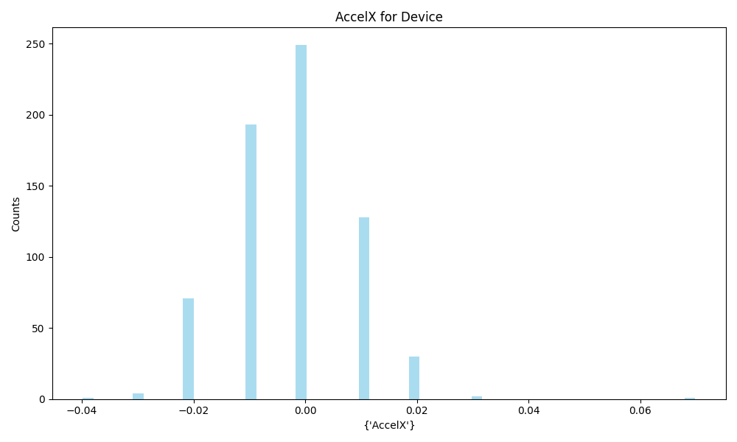
AccelX | Metric
Count | 679
Mean | -0.00
Std | 0.01
Min | -0.04
Max | 0.07

Slide 3
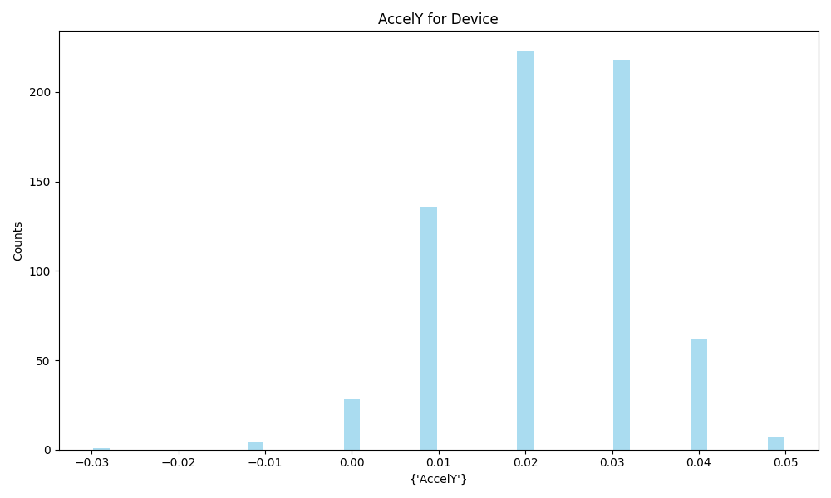
AccelY | Metric
Count | 679
Mean | 0.02
Std | 0.01
Min | -0.03
Max | 0.05

Slide 4
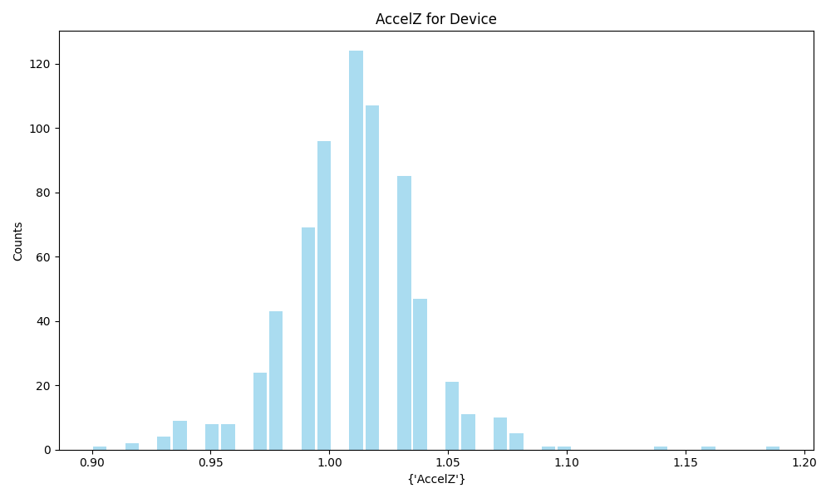
AccelZ | Metric
Count | 679
Mean | 1.01
Std | 0.03
Min | 0.9
Max | 1.19

Slide 5
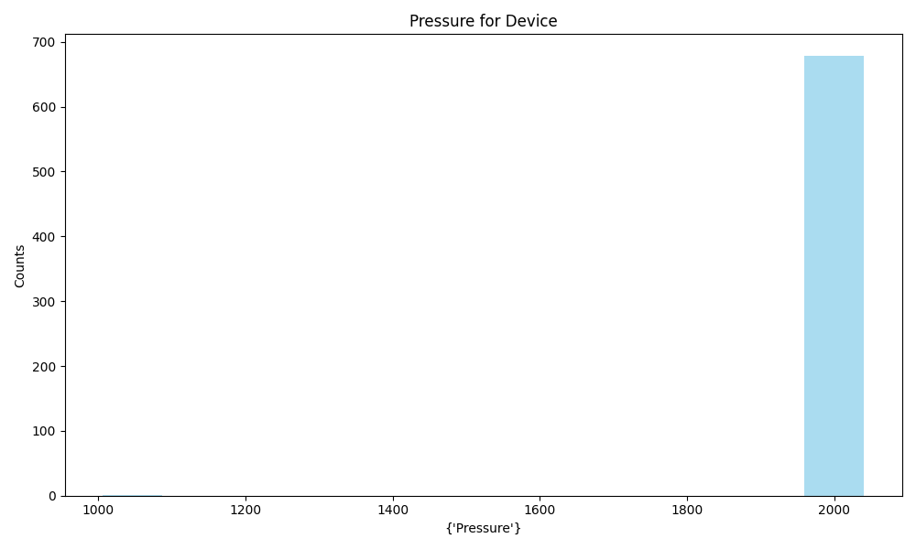
Pressure | Metric
Count | 679
Mean | 2046.45
Std | 40.23
Min | 998.92
Max | 2048.0

Slide 6
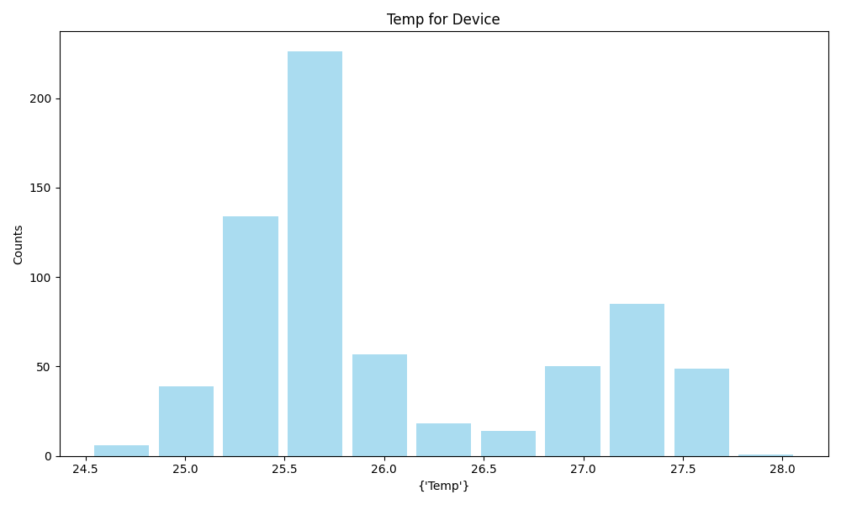
Temp | Metric
Count | 679
Mean | 26.05
Std | 0.81
Min | 24.52
Max | 28.08

Slide 7
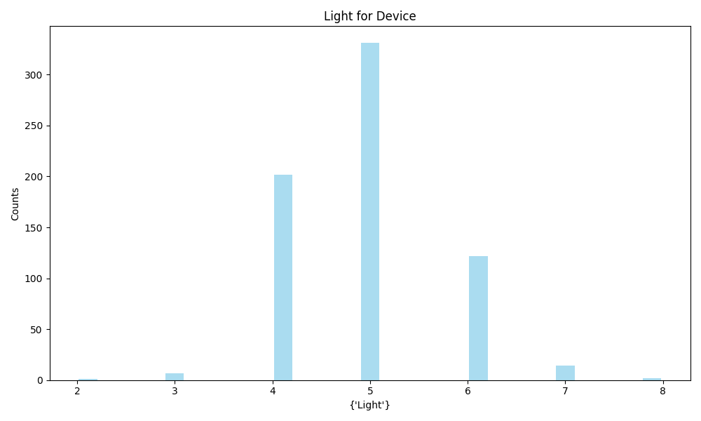
Light | Metric
Count | 679
Mean | 4.91
Std | 0.80
Min | 2.0
Max | 8.0

Slide 8
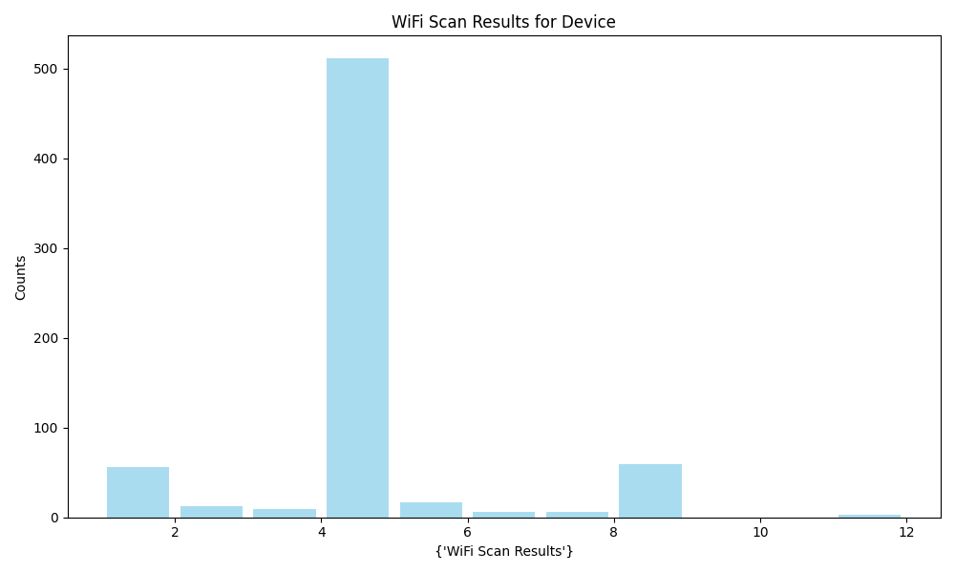
WiFi Scan Results | Metric
Count | 679
Mean | 4.16
Std | 1.62
Min | 1
Max | 12

Slide 9
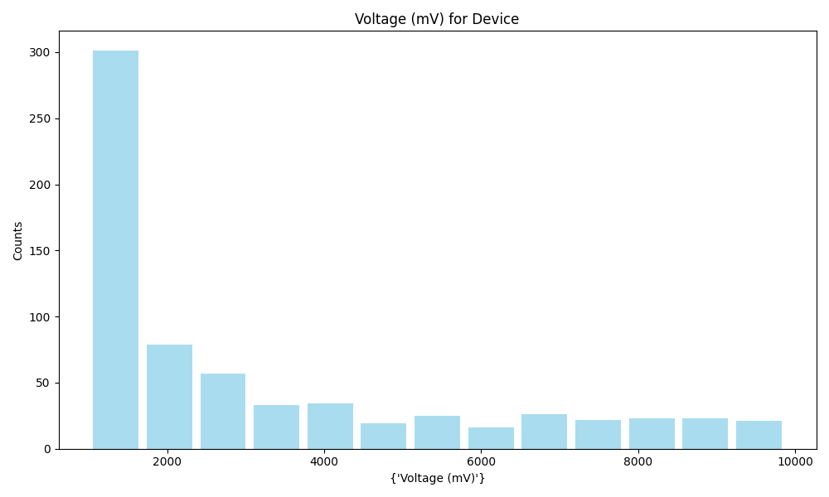
Voltage (mV) | Metric
Count | 679
Mean | 3289.71
Std | 2537.07
Min | 1002.885
Max | 9880.363

Slide 10
PCBA

Slide 11
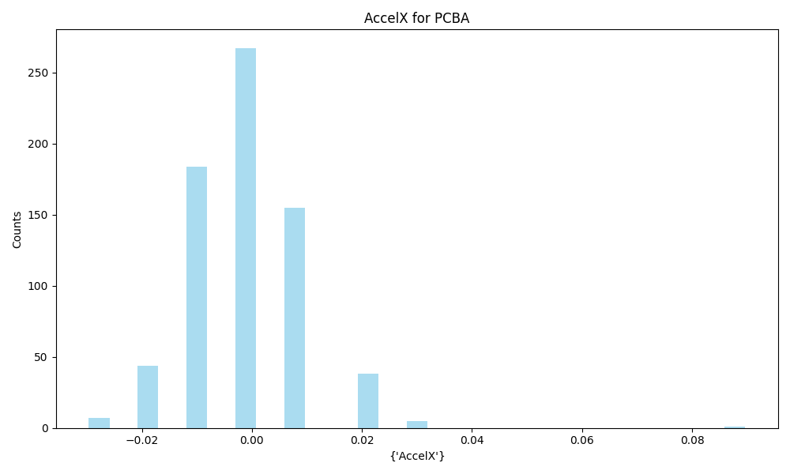
AccelX | Metric
Count | 701
Mean | -0.00
Std | 0.01
Min | -0.03
Max | 0.09

Slide 12
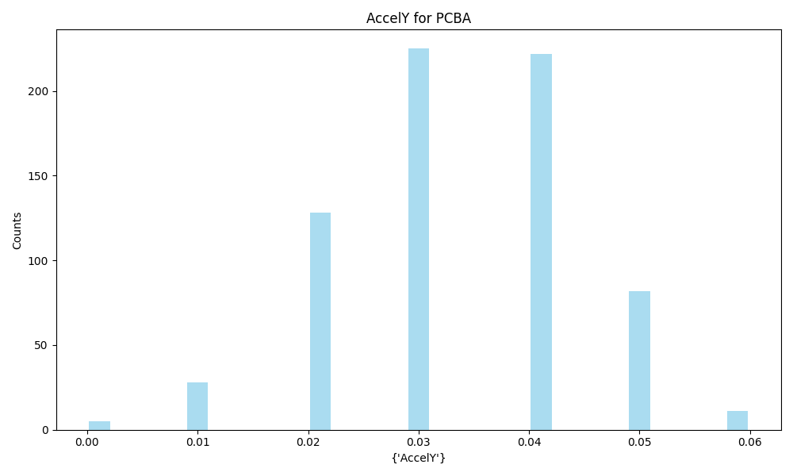
AccelY | Metric
Count | 701
Mean | 0.03
Std | 0.01
Min | 0.0
Max | 0.06

Slide 13
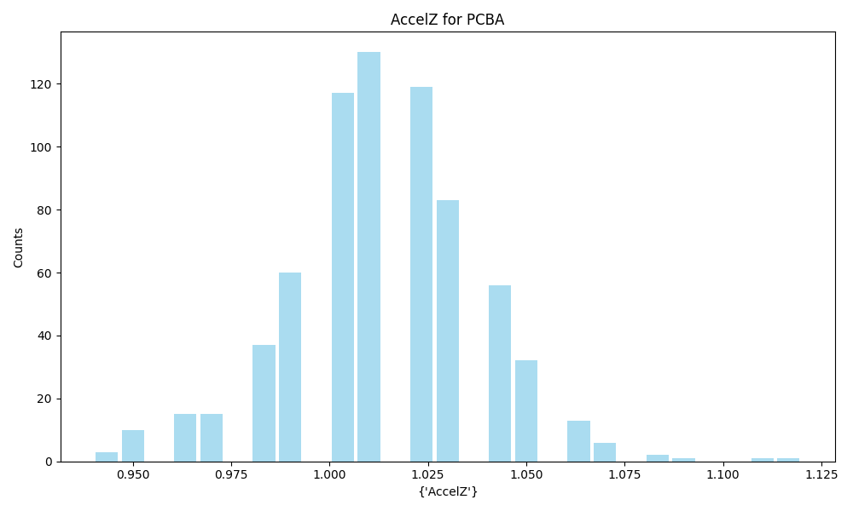
AccelZ | Metric
Count | 701
Mean | 1.01
Std | 0.02
Min | 0.94
Max | 1.12

Slide 14
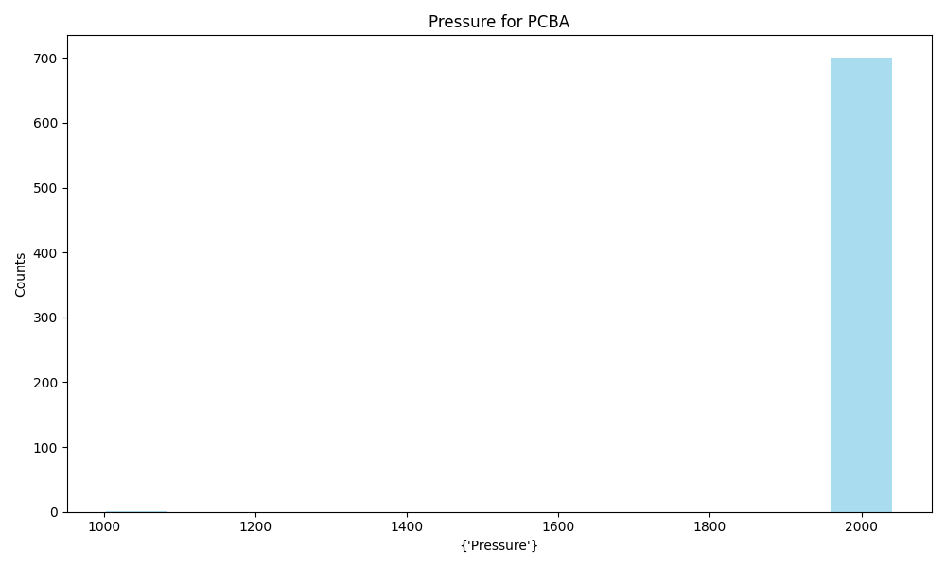
Pressure | Metric
Count | 701
Mean | 2046.50
Std | 39.70
Min | 996.17
Max | 2048.0

Slide 15
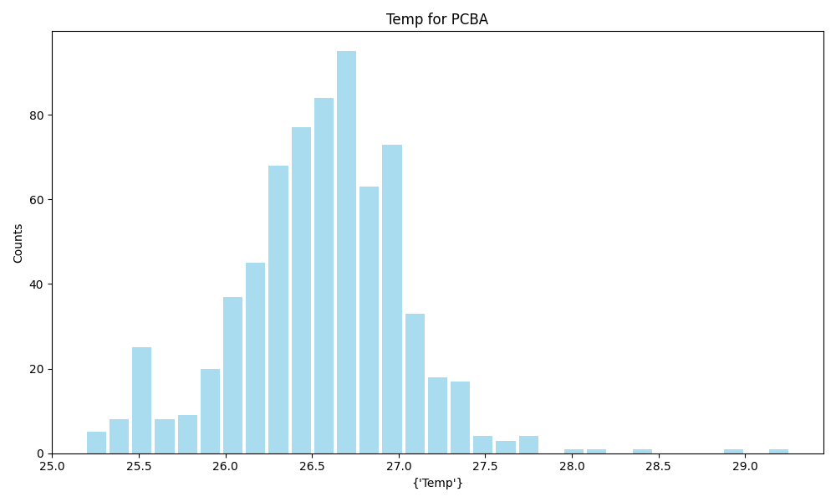
Temp | Metric
Count | 701
Mean | 26.55
Std | 0.49
Min | 25.19
Max | 29.26

Slide 16
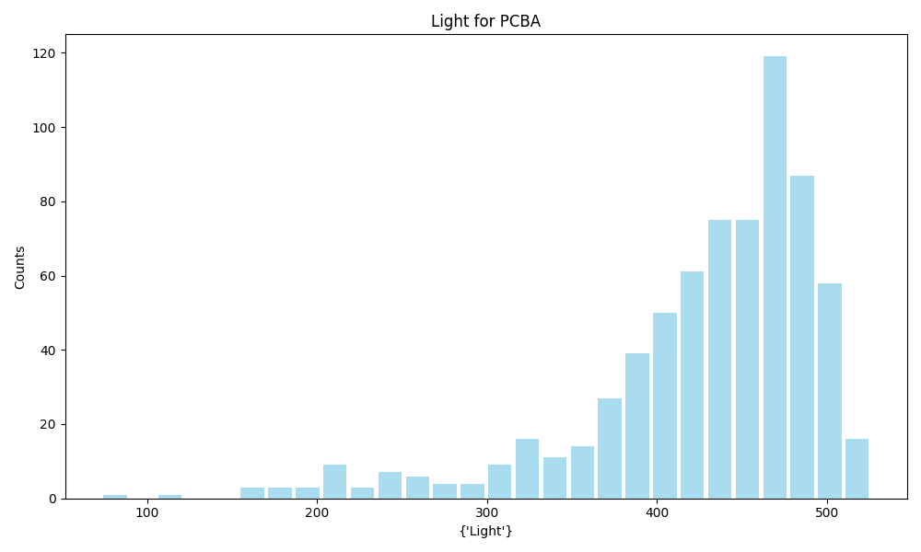
Light | Metric
Count | 701
Mean | 427.84
Std | 70.79
Min | 73.0
Max | 526.0

Slide 17
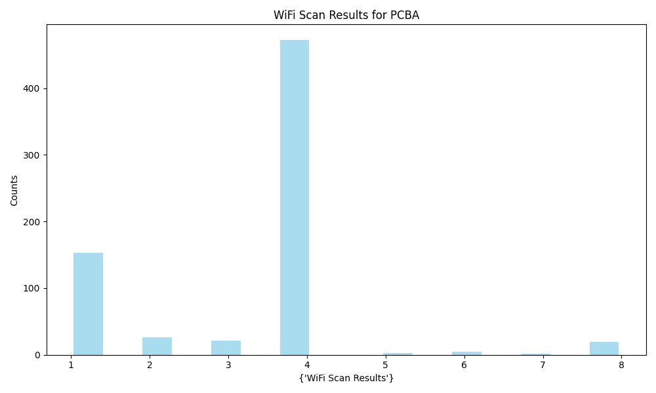
WiFi Scan Results | Metric
Count | 701
Mean | 3.38
Std | 1.50
Min | 1
Max | 8

Slide 18
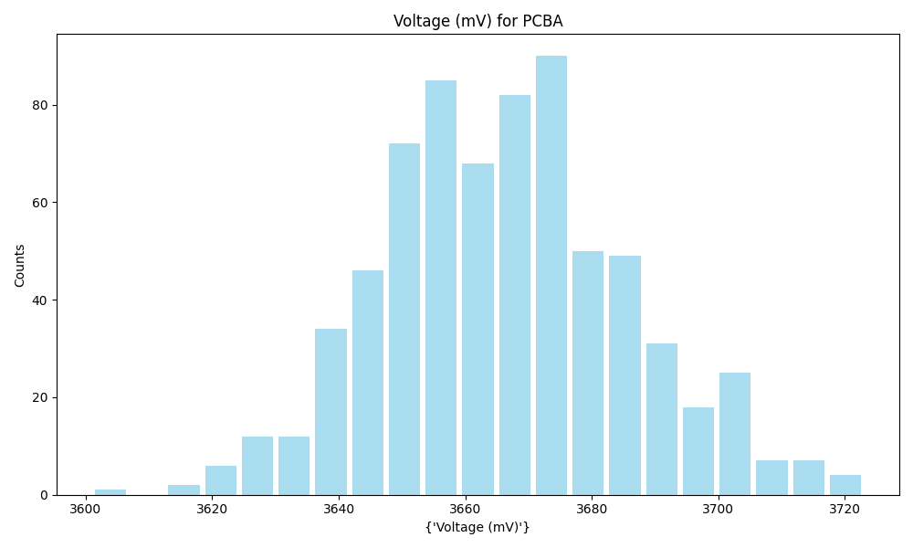
Voltage (mV) | Metric
Count | 701
Mean | 3666.15
Std | 19.65
Min | 3601.0
Max | 3723.0

Slide 19
RF_conduction

Slide 20
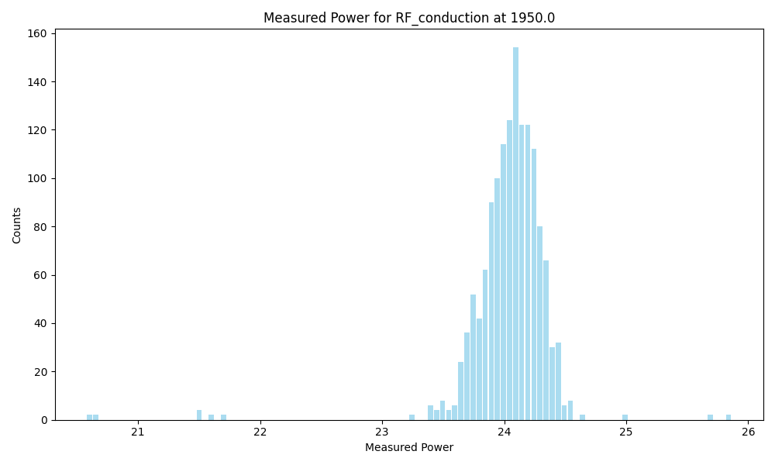
Frequency | 1950.0
Count | 1426
Mean | 24.04
Std | 0.35
Min | 20.57819
Max | 25.86422

Slide 21
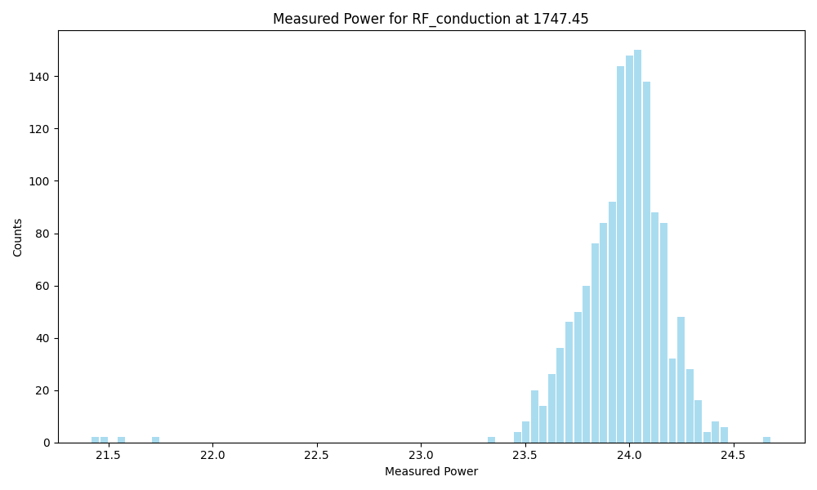
Frequency | 1747.45
Count | 1422
Mean | 23.96
Std | 0.26
Min | 21.41619
Max | 24.68214

Slide 22
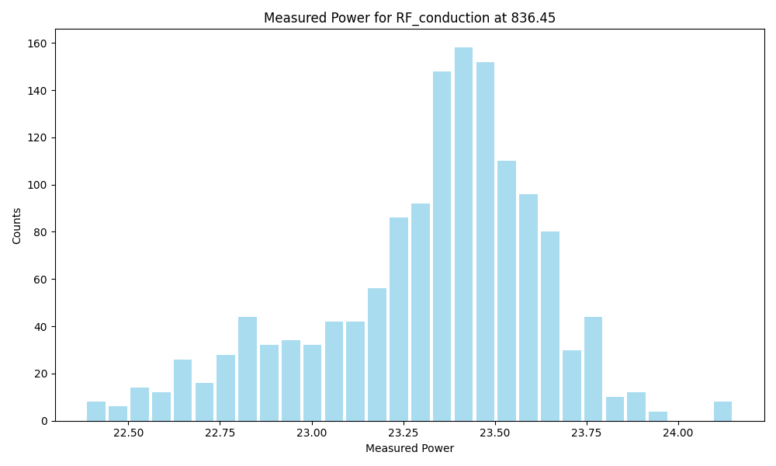
Frequency | 836.45
Count | 1422
Mean | 23.32
Std | 0.31
Min | 22.38327
Max | 24.15143

Slide 23
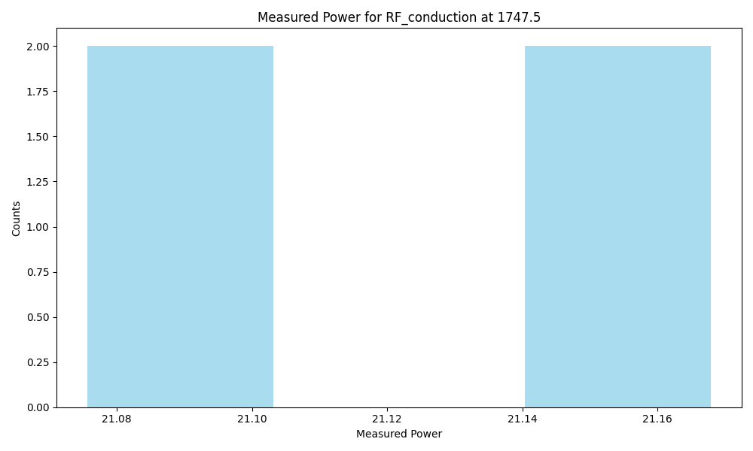
Frequency | 1747.5
Count | 4
Mean | 21.12
Std | 0.05
Min | 21.07325
Max | 21.1703

Slide 24
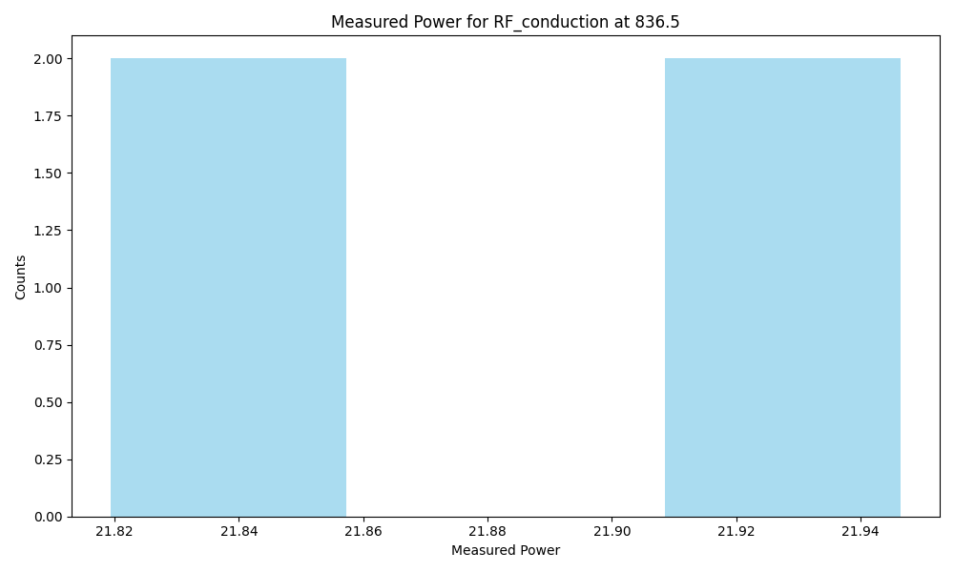
Frequency | 836.5
Count | 4
Mean | 21.88
Std | 0.07
Min | 21.81611
Max | 21.94969

Slide 25
RF_coupling

Slide 26
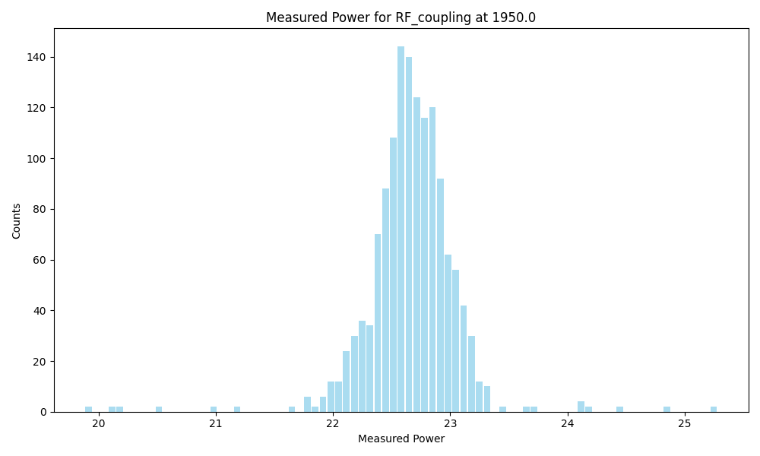
Frequency | 1950.0
Count | 1408
Mean | 22.66
Std | 0.39
Min | 19.88094
Max | 25.28123

Slide 27
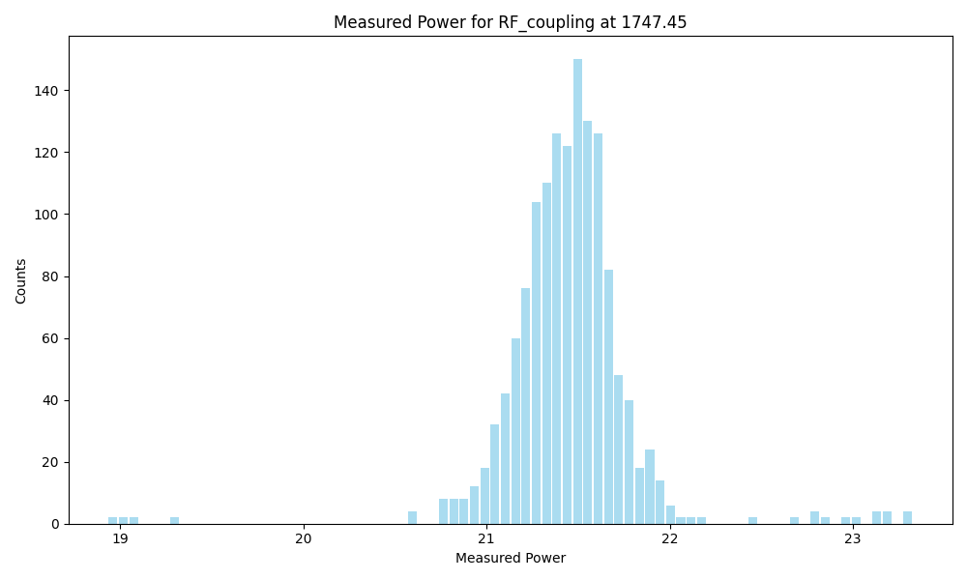
Frequency | 1747.45
Count | 1408
Mean | 21.45
Std | 0.36
Min | 18.93163
Max | 23.32776

Slide 28
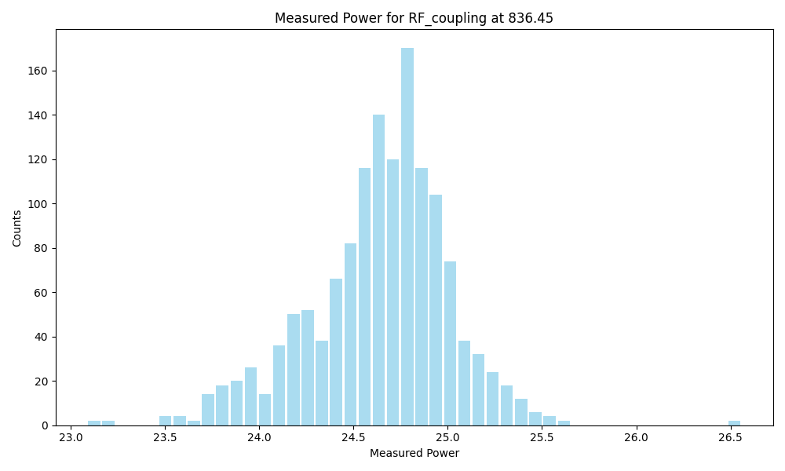
Frequency | 836.45
Count | 1408
Mean | 24.64
Std | 0.37
Min | 23.087
Max | 26.55909

